Slide 1
Pitch deck

Slide 2
About us
This is where Foodie Finder comes in—a web app that instantly connects you to the food you're craving based on your preferences and location.

Slide 3

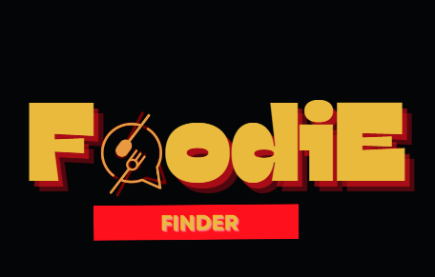
Company

Slide 4
Problem
Are you tired of spending endless time deciding what to eat? With numerous options and busy schedules, choosing the right meal quickly can be overwhelming.

Slide 5
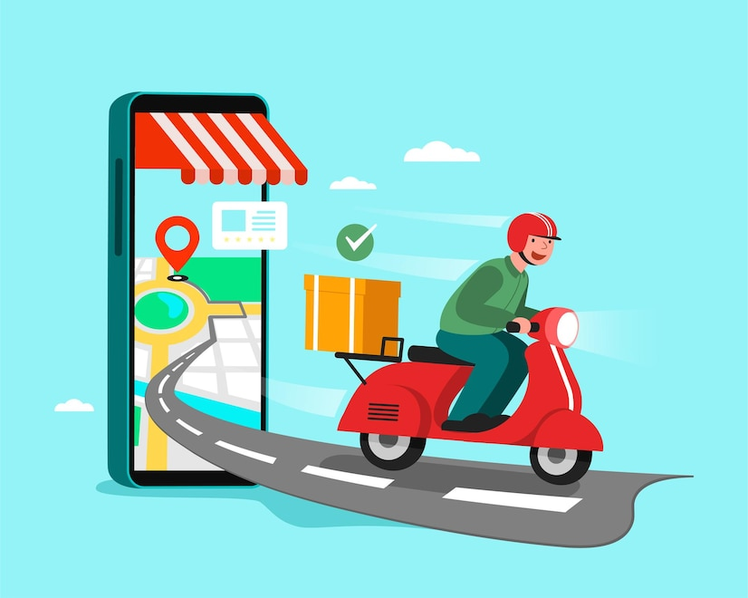
Solution
A web app that simplifies food discovery in three keyways:

Slide 6
Personalized Recommendations:
Geo-based Results:
Quick and Easy Filters:
Based on your food preferences, dietary restrictions, and previous orders, Foodie Finder suggests tailored options that match exactly what you're looking for.
Using your location, Foodie Finder shows you only the most relevant options nearby, so you're never stuck with restaurants too far away.
Want something vegan? Spicy? Gluten-free? No problem. Our filter options are incredibly user-friendly, helping you zero in on your cravings in seconds.

Slide 7
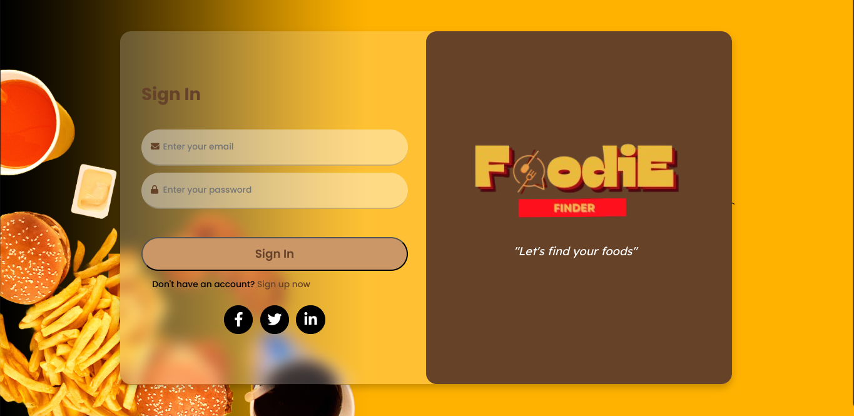
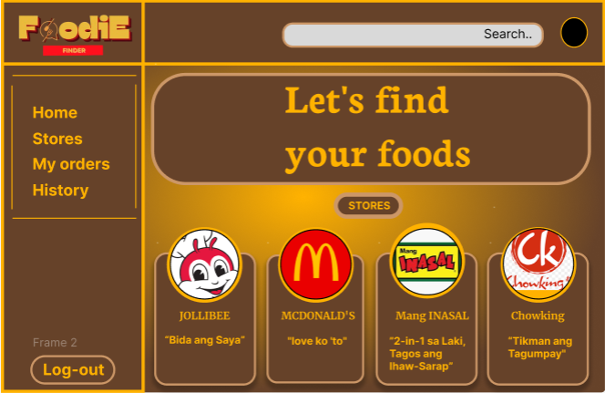
Product
LOG IN
PICK YOUR STORE
ORDER IT!

Slide 8
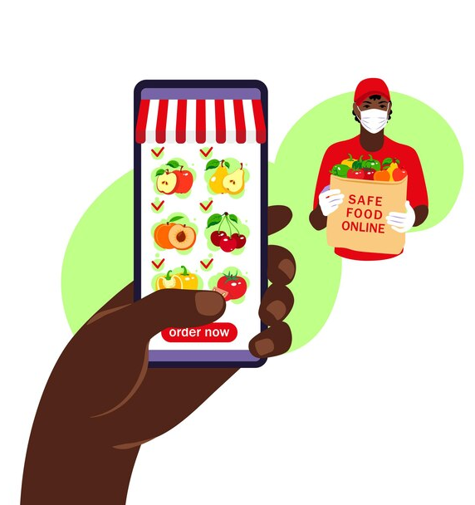
Market and Impact
The global food delivery market is massive and still growing. People are constantly searching for faster, more convenient ways to find food that fits their lifestyle. With the rise of personalized tech, Foodie Finder taps into the growing demand for simplicity and precision. Our app reduces the time people spend deciding, turning what used to be an overwhelming process into a delightful and efficient experience

Slide 9


Competition

Slide 10
Benefits
Saves time – less time-consuming preparing and making your meal.
Convenience – order and eat.
Saves money – saves money for necessary cooking
Easy to use – simple ui for faster ordering.
Lots of options – choose your favorite food store.

Slide 11


Thank you

